Slide 1




introduction to
abstract factory
- Group 2 -
Group 02
Learn More

Slide 2


0. contents
01
INTRODUCTORY PROBLEM
02
ABSTRACT FACTORY PATTERN
03
APPLICATIONS
Group 02
04
IMPLEMENTATION
05
QUIZZES

Slide 3

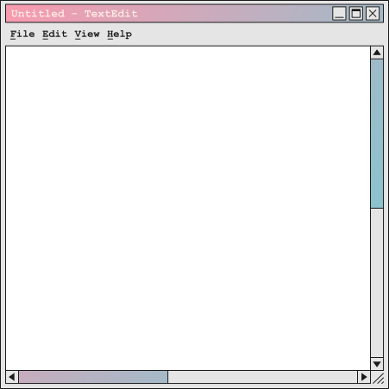
introduction
You are building a
cross-platform text editor:
There are buttons, checkboxes, textboxes, ...
It works on Windows, Mac and Linux.
The UI components match the style of the operating system.
Your company also plans to support additional platforms and UI compoments.
How would you implement it?
Group 02

Slide 4









Naive Solution
Naive Solution
if (os == "Windows") {
button = new WindowsButton;
checkbox = new WindowsCheckbox;
}
else if (os == "Mac") {
button = new MacButton;
checkbox = new MacCheckbox;
}
...
Your first try
Group 02
Hard coding with if-elses whenever an UI component is needed.

Slide 5
Problems of the Naive Solution
1
Violation of Open-Closed Principle
2
Tight Coupling
Adding a new platform requires modifying existing code in every place components are created.
Client code depends directly on concrete classes, making it hard to swap implementations.
3
Family Consistency Not Guaranteed
4
Duplicate Creation Logic
Nothing prevents mixing components from different families (e.g. WinButton + MacCheckbox).
The same if-else blocks are scattered across the codebase wherever components are instantiated.
Group 02

Slide 6

Second Naive Attempt
Second Naive Attempt
// lets abstract the style of the UI component created
Button button = ButtonFactory::create(os);
Checkbox checkbox = CheckboxFactory::create(os);
...
Second naive attempt
Group 02
Creation is moved into factory calls, but the client still chooses the OS and duplicates the pattern for each product type.
=> Cannot fix all problems.

Slide 7
ABSTRACT FACTORY
Abstract Product
Concrete Product
Abstract Factory
An interface or abstract class for a distinct type of product within a family.
Ex: Button or Checkbox
Specific products.
Ex: WinButton and MacButton implement Button.
Ex: WinCheckbox and
MacCheckbox implement Checkbox.
An interface declaring a set of creation methods for each abstract product
type
Ex: createButton() and createCheckbox()
Concrete Factory
Client
Specific classes that implement the Abstract Factory to produce a concrete variant.
Ex: WinFactory creates WinButton and WinCheckbox
The application code that uses only the interfaces declared by AbstractFactory and
AbstractProduct
Group 02

Slide 8

iMPLEmentation
Group 02

Slide 9

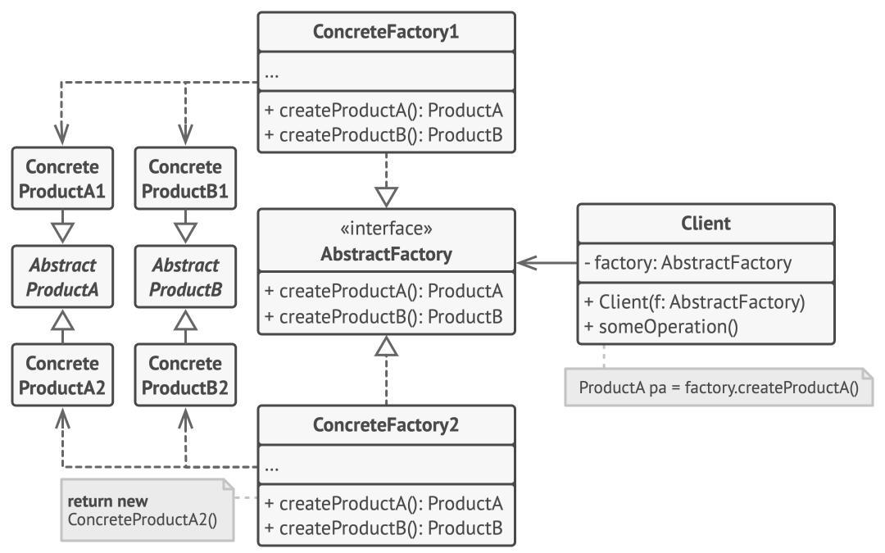
General Class Diagram
Group 02

Slide 10
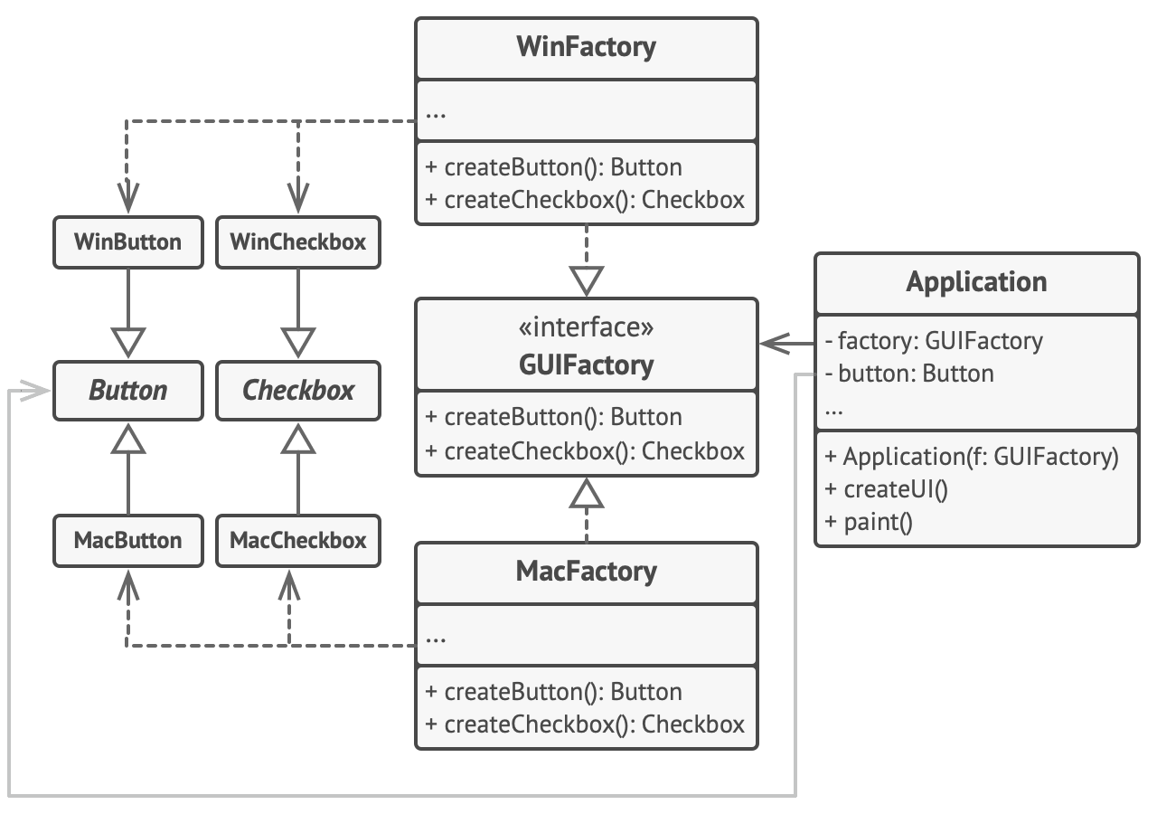
Solution Class Diagram
Group 02

Slide 11

SAMPLE CODE
Group 02

Slide 12
Group 02
Pros and cons
Learn More

Slide 13
advantages
1
Dependency Inversion Principle
2
Decouples the Client
The pattern ensures that client code
depends on high-level abstractions rather than concrete implementations.
By returning abstract product types rather
than concrete classes, the pattern isolates the client from implementation details
3
Product Consistency
4
Ease of Adding Product Families
The pattern is designed to create families of related objects, ensuring to receive compatible objects from the same family.
Adding a new product families, such as a new OS GUI factory, is easy and doesn’t require changes to existing client code.
Group 02

Slide 14
Disadvantages
1
New Product Types
2
Increased System Complexity
Requiring altering the main Abstract Factory interface and cascading those changes across all existing concrete factory
The pattern introduces many new interfaces and classes into the codebase, make the system more complex
3
Upfront Design Overhead
Requiring correctly predicting the variations of product families early in the design phase. Or the structure can become a nightmare
Group 02

Slide 15
04
other applications
Group 02
Learn More

Slide 16

Game Development & Level Theming
Abstract Factory:
BiomeFactory
Products:
Enemy
Weapon
Concrete Factories:
IceFactory
NetherFactory
Group 02

Slide 17
05
QuizESS
Group 02
Learn More

Slide 18
1.What is the main purpose of the Abstract Factory Pattern?
B. Create families of related objects without specifying their concrete classes.
A. Ensure a class has only one instance.
C. Separate complex object construction.
D. Change an object’s behavior.
Group 02

Slide 19
1.What is the main purpose of the Abstract Factory Pattern?
B. Create families of related objects without specifying their concrete classes.
A. Ensure a class has only one instance.
C. Separate complex object construction.
D. Change an object’s behavior.
Group 02

Slide 20
2.How does Abstract Factory differ from Factory Method?
A. Factory Method creates families; Abstract Factory creates single objects.
B. Abstract Factory uses inheritance; Factory Method uses composition.
C. Abstract Factory creates product families; Factory Method creates a single product type.
D. They are identical.
Group 02

Slide 21
2.How does Abstract Factory differ from Factory Method?
A. Factory Method creates families; Abstract Factory creates single objects.
B. Abstract Factory uses inheritance; Factory Method uses composition.
C. Abstract Factory creates product families; Factory Method creates a single product type.
D. They are identical.
Group 02

Slide 22
3.What is a major disadvantage of Abstract Factory?
B. Adding new product types requires changing the factory interface and all subclasses.
A. It tightly couples client code to concrete classes.
C. Adding new product families is nearly impossible.
D. It exposes instantiation logic to the client.
Group 02

Slide 23
3.What is a major disadvantage of Abstract Factory?
B. Adding new product types requires changing the factory interface and all subclasses.
A. It tightly couples client code to concrete classes.
C. Adding new product families is nearly impossible.
D. It exposes instantiation logic to the client.
Group 02

Slide 24
4.Which scenario is best suited for Abstract Factory?
A. A cross-platform UI toolkit with OS-specific buttons, checkboxes, and text fields.
B. A logger writing to either a file or a database.
C. A document parser building a DOM tree step-by-step.
D. A caching system cloning objects.
Group 02

Slide 25
4.Which scenario is best suited for Abstract Factory?
A. A cross-platform UI toolkit with OS-specific buttons, checkboxes, and text fields.
B. A logger writing to either a file or a database.
C. A document parser building a DOM tree step-by-step.
D. A caching system cloning objects.
Group 02

Slide 26
5.Which component actually creates concrete objects?
A. The Client
B. The Abstract Factory Interface
C. The Concrete Factories
D. The Abstract Products
Group 02

Slide 27
5.Which component actually creates concrete objects?
A. The Client
B. The Abstract Factory Interface
C. The Concrete Factories
D. The Abstract Products
Group 02

Slide 28
6.Which pattern is often combined with Concrete Factories?
A. Observer
B. Singleton
C. Strategy
D. Decorator
Group 02

Slide 29
6.Which pattern is often combined with Concrete Factories?
A. Observer
B. Singleton
C. Strategy
D. Decorator
Group 02

Slide 30
7.What should factory creation methods return?
A. Concrete types (e.g., WindowsButton)
B. Abstract product interfaces (e.g., IButton)
C. Generic objects (Object, Any)
D. Boolean success flags
Group 02

Slide 31
7.What should factory creation methods return?
A. Concrete types (e.g., WindowsButton)
B. Abstract product interfaces (e.g., IButton)
C. Generic objects (Object, Any)
D. Boolean success flags
Group 02

Slide 32
8.Which SOLID principle does Abstract Factory promote most?
A. Single Responsibility Principle
B. Open/Closed Principle
C. Liskov Substitution Principle
D. Dependency Inversion Principle
Group 02

Slide 33
8.Which SOLID principle does Abstract Factory promote most?
A. Single Responsibility Principle
B. Open/Closed Principle
C. Liskov Substitution Principle
D. Dependency Inversion Principle
Group 02

Slide 34
abstract factory vs.
factory method
1
abstract factory
2
factory method
Scope: Creates families of related objects without specifying their concrete classes
Mechanism: Relies on object composition; creation is delegated to multiple factory methods exposed in an interface.
Design Level: Operates at a higher level of abstraction. It is often implemented using a set of Factory Methods.
Scope: Creates single specific objects or products.
Mechanism: Relies on inheritance; it defines an interface for creating an object, but lets subclasses decide which class to instantiate.
Design Level: Operates strictly at the method level.
Group 02

Slide 35
ABSTRACT FACTORY
VS
ADAPTER
Abstract FACTORY
ADAPTER
Abstract Factory is a Creational pattern.
It creates families of related objects without specifying concrete classes.
Adapter is a Structural pattern that wraps an incompatible class with the interface a client expects.
Group 02

Slide 36

tHaNk you
For Your Attention
Studio Shodwe

